Slide 1
UPPER SIXTH ARTS
GEOGRAPHY
Lesson 18
The Changing Nature of Industrial Location
Notes:
Good morning, class, and welcome to our geography lesson. I am your geography teacher, Mr Kamdem. Today we are starting Lesson 18: The Changing Nature of Industrial Location.

Slide 2
CLASS INFO
Class, Chapter and Duration
Class | Upper Sixth Arts
Chapter | Module 6: Understanding and managing the dynamics of economic activities across the world in general and Cameroon in particular
Duration | 2 periods (2 × 50 minutes)
Notes:
This lesson is for Upper Sixth Arts. It belongs to Module 6: Understanding and managing the dynamics of economic activities across the world in general and Cameroon in particular. We shall need 2 periods to cover it.

Slide 3
IDENTIFICATION
Lesson Identification
Topic | Distribution of Industries
Sub-topic | Distribution of Industries
Lesson | Lesson 18: The Changing Nature of Industrial Location
Notions / Concepts | Industrial shift, relocation, iron and steel industry, coastal location, global shift.
Syllabus focus | Meaning; the case of iron and steel; factors and implications of changes.
Competence | Learners are able to explain why industrial locations change over time.
Notes:
Our topic is Distribution of Industries, and the sub-topic is Distribution of Industries. The key notions we shall use today are: industrial shift, relocation, iron and steel industry, coastal location, global shift. At the end, you should be able to do this: learners are able to explain why industrial locations change over time.

Slide 4

HOMEWORK CORRECTION
Correction of the Homework
Question (Lesson 17: Government Policy and Industrial Location):
Suggest how the government could attract industries to your region.
Notes:
Before we start the new lesson, let us correct the homework I gave you at the end of Lesson 17: Government Policy and Industrial Location. The question was: Suggest how the government could attract industries to your region. Take out your exercise books.

Slide 5
HOMEWORK CORRECTION
Correction: Possible Answer
To attract industries to the North: build roads and electricity from Lagdo, give tax holidays and cheap land, create an industrial zone at Garoua, train workers and process local cotton, cattle and onions.
Notes:
Here is a good answer. To attract industries to the North: build roads and electricity from Lagdo, give tax holidays and cheap land, create an industrial zone at Garoua, train workers and process local cotton, cattle and onions. Compare it with your own answer and correct your work in red.

Slide 6
LESSON PLAN
Lesson Plan
Correction of the homework
Objectives and recall
Real-life situation and action to take
Learning activities
Board summary
Evaluation, remediation and homework
Notes:
Here is the plan of our lesson today. First, we shall correct the homework. Then we shall look at the objectives and recall what you already know. After that, we shall study a situation from real life and the action to take, and do the learning activities. Finally, we shall copy the board summary, do the evaluation and the remediation, and I will give you the homework.

Slide 7
OBJECTIVES
Objectives
By the end of this lesson, you should be able to:
Explain what a change in industrial location means.
Explain the changing location of iron and steel.
Notes:
Take your time to copy this part; we will continue together.

Slide 8
OBJECTIVES
Objectives (continued)
Explain the factors and implications.
Notes:
By the end of this lesson, you should be able to do three things. Number 1: explain what a change in industrial location means. Number 2: explain the changing location of iron and steel. Number 3: explain the factors and implications.

Slide 9
PREVIOUS KNOWLEDGE
Previous Knowledge
Location factors change over time.
Heavy industry used much coal.
Notes:
Let us first remember what you already know. Location factors change over time. Heavy industry used much coal. Keep this in mind, because we shall build on it today.

Slide 10
REAL-LIFE SITUATION
Situation in Real Life
In the 1800s, steel works in Britain were built on coalfields. Today, the biggest steel works are on the coasts, and most steel is made in China.
Notes:
Listen carefully to this situation from real life. In the 1800s, steel works in Britain were built on coalfields. Today, the biggest steel works are on the coasts, and most steel is made in China. Think about it, because I am going to ask you some questions.

Slide 11
REAL-LIFE SITUATION
Situation: Question 1
What is the problem in the situation?
Notes:
Question 1: What is the problem in the situation? Think for a moment, then raise your hand to answer.

Slide 12
REAL-LIFE SITUATION
Answer
Industries have moved to new places.
Notes:
Good. Industries have moved to new places.

Slide 13
REAL-LIFE SITUATION
Situation: Question 2
Why were steel works on coalfields?
Notes:
Question 2: Why were steel works on coalfields? Think for a moment, then raise your hand to answer.

Slide 14
REAL-LIFE SITUATION
Answer
They used huge amounts of coal.
Notes:
Good. They used huge amounts of coal.

Slide 15
REAL-LIFE SITUATION
Situation: Question 3
Why are they now on coasts?
Notes:
Question 3: Why are they now on coasts? Think for a moment, then raise your hand to answer.

Slide 16
REAL-LIFE SITUATION
Possible Answer
They import ore and coal by sea.
Notes:
Good. They import ore and coal by sea.

Slide 17
ACTION TO TAKE
Action to Take
Understand changes in industrial location and their effects on regions.
Notes:
From this situation, the action we are working towards in this lesson is the following: understand changes in industrial location and their effects on regions.

Slide 18
JUSTIFICATION
Justification of the Lesson
This lesson helps us to understand that industrial geography keeps changing.
Notes:
Why is this lesson important for you? This lesson helps us to understand that industrial geography keeps changing.

Slide 19
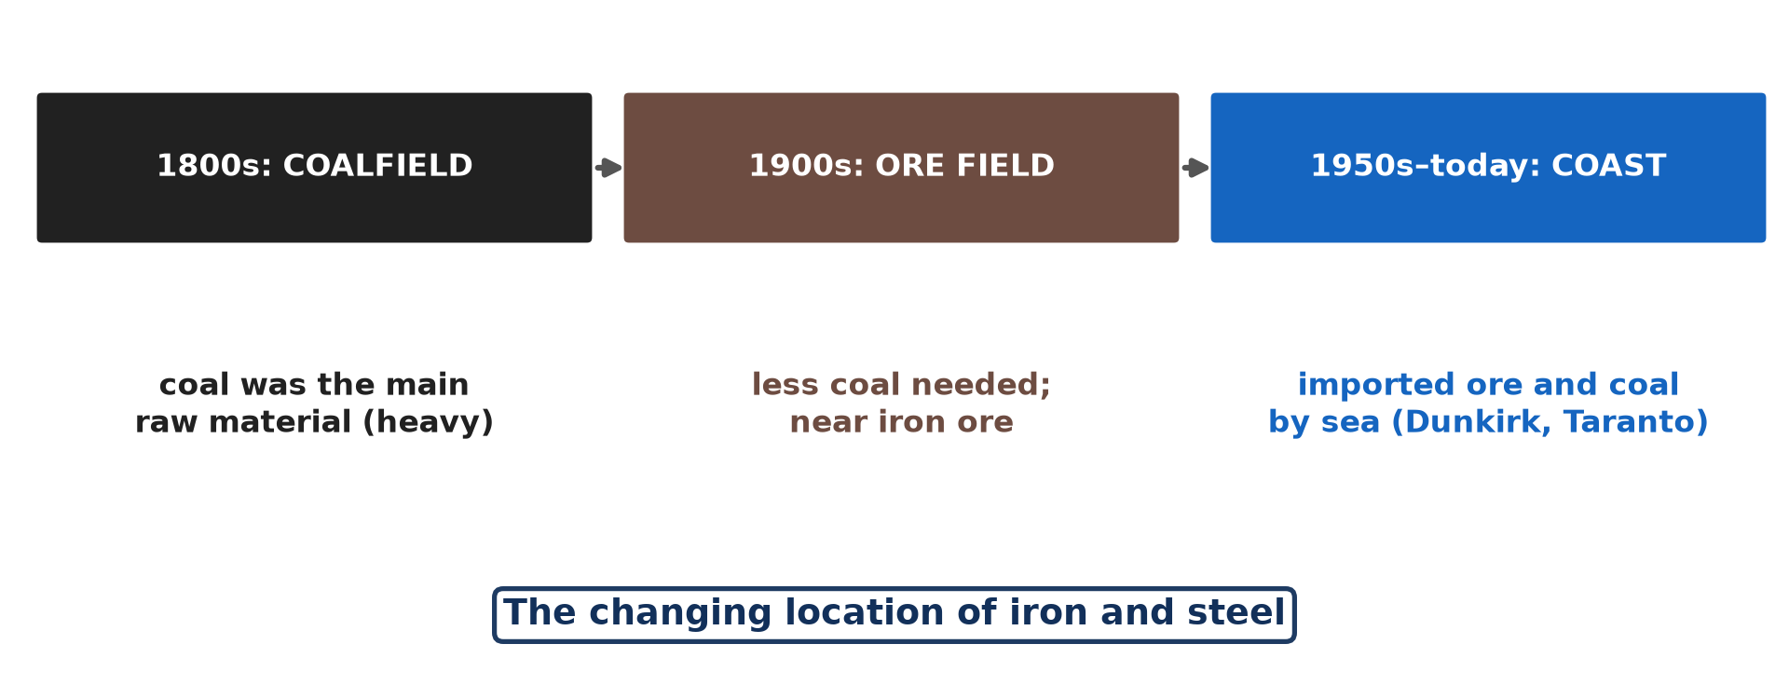
1. MEANING
Activity 1
The changing location of iron and steel.
Notes:
Activity 1. Look carefully at this diagram: the changing location of iron and steel. Observe every detail before I ask the question.

Slide 20
1. MEANING
Activity 1: Question
Describe the three stages of steel location.
Notes:
Here is the question for Activity 1: Describe the three stages of steel location. Take one minute to think and write your answer in your rough notebook.

Slide 21
1. MEANING
Activity 1: Answer
Coalfields, then ore fields, then coasts.
Notes:
Let us check the answer together. Coalfields, then ore fields, then coasts.

Slide 22

2. CASE STUDY: IRON AND STEEL
Activity 2
A steel works.
Notes:
Activity 2. Look carefully at this picture: a steel works. Observe every detail before I ask the question.

Slide 23
2. CASE STUDY: IRON AND STEEL
Activity 2: Question
Why did steel works move from coalfields?
Notes:
Here is the question for Activity 2: Why did steel works move from coalfields? Take one minute to think and write your answer in your rough notebook.

Slide 24
2. CASE STUDY: IRON AND STEEL
Activity 2: Answer
Less coal was needed and local coal and ore ran out.
Notes:
Let us check the answer together. Less coal was needed and local coal and ore ran out.

Slide 25

2. CASE STUDY: IRON AND STEEL
Activity 3
A large ship.
Notes:
Activity 3. Look carefully at this picture: a large ship. Observe every detail before I ask the question.

Slide 26
2. CASE STUDY: IRON AND STEEL
Activity 3: Question
Why are modern steel works on the coast?
Notes:
Here is the question for Activity 3: Why are modern steel works on the coast? Take one minute to think and write your answer in your rough notebook.

Slide 27
2. CASE STUDY: IRON AND STEEL
Activity 3: Answer
They import ore and coal by cheap bulk ships and export steel.
Notes:
Let us check the answer together. They import ore and coal by cheap bulk ships and export steel.

Slide 28
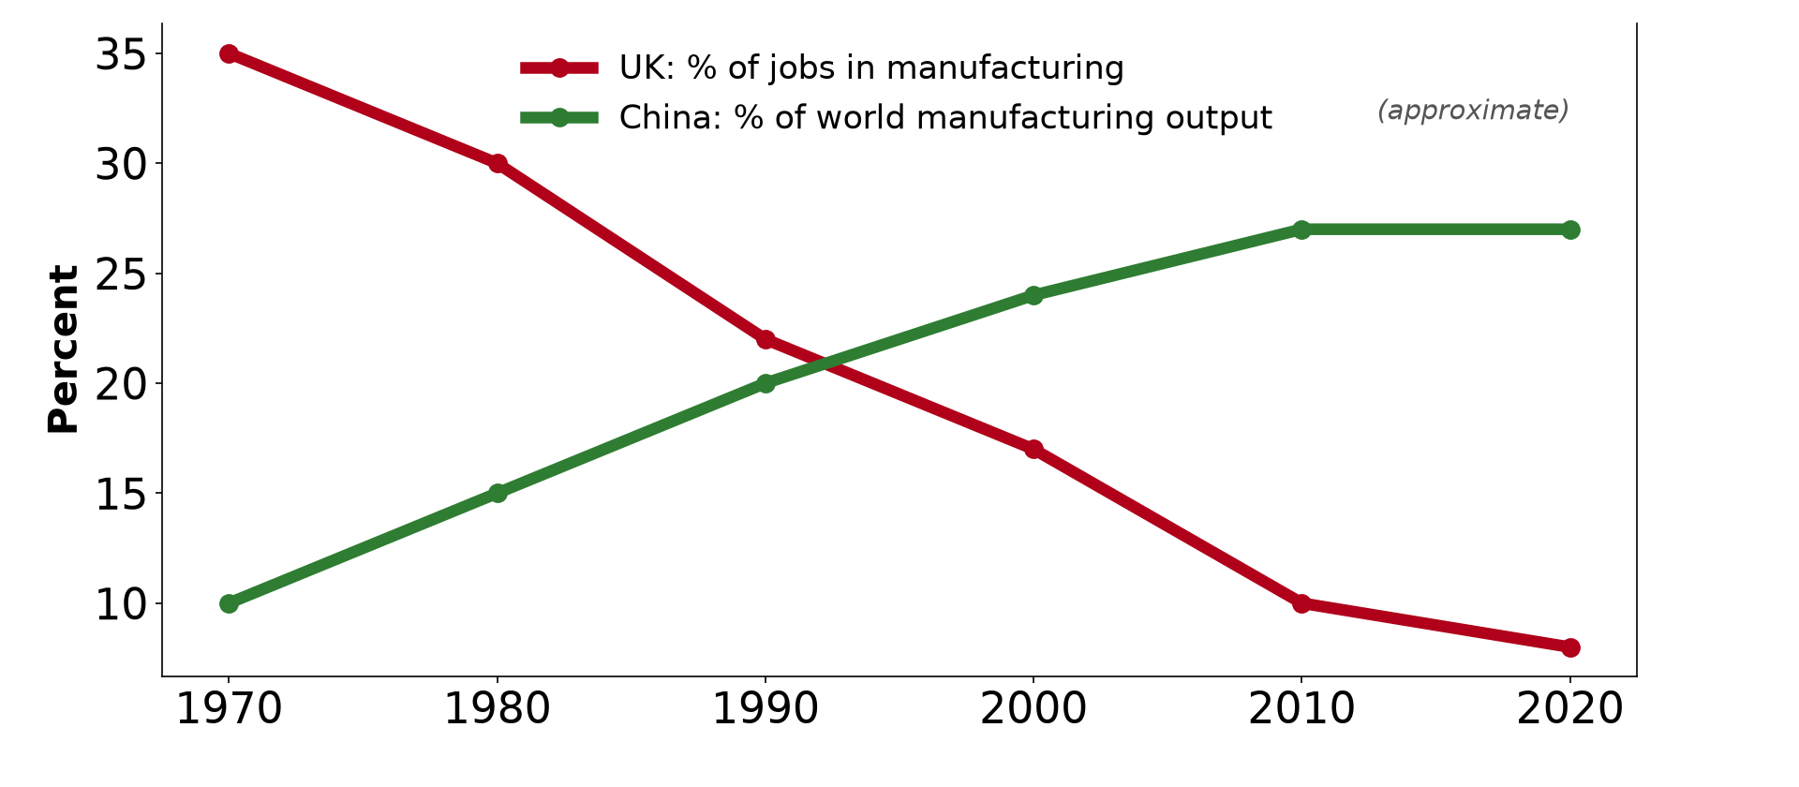
3. FACTORS: GLOBAL SHIFT
Activity 4
Manufacturing in the UK and China (approximate).
Notes:
Activity 4. Look carefully at this diagram: manufacturing in the UK and China (approximate). Observe every detail before I ask the question.

Slide 29
3. FACTORS: GLOBAL SHIFT
Activity 4: Question
What is the global shift in manufacturing?
Notes:
Here is the question for Activity 4: What is the global shift in manufacturing? Take one minute to think and write your answer in your rough notebook.

Slide 30
3. FACTORS: GLOBAL SHIFT
Activity 4: Answer
The move of factories from old industrial countries to Asia.
Notes:
Let us check the answer together. The move of factories from old industrial countries to Asia.

Slide 31

3. IMPLICATIONS
Activity 5
A modern factory with robots.
Notes:
Activity 5. Look carefully at this picture: a modern factory with robots. Observe every detail before I ask the question.

Slide 32
3. IMPLICATIONS
Activity 5: Question
Give one implication for old industrial regions.
Notes:
Here is the question for Activity 5: Give one implication for old industrial regions. Take one minute to think and write your answer in your rough notebook.

Slide 33
3. IMPLICATIONS
Activity 5: Answer
Unemployment and derelict land (need for new industries).
Notes:
Let us check the answer together. Unemployment and derelict land (need for new industries).

Slide 34
BOARD SUMMARY
Board Summary
Topic: Distribution of Industries
Sub-topic: Distribution of Industries
Lesson 18: The Changing Nature of Industrial Location
Notes:
Now we are going to copy the board summary. Write the title and the headings neatly in your notebooks. I will give you enough time for each slide, so do not rush.

Slide 35
BOARD SUMMARY
1. Meaning
The changing nature of industrial location can be understood as follows:
Meaning: It is the movement of industries from old locations to new ones when the factors of location change. It happens at local, national and global scales.
Notes:
Let us copy Meaning. The changing nature of industrial location can be understood as follows. On this slide we have Meaning. Write each point on a new line, with the key term first, and explain it in your own words when we revise.

Slide 36
BOARD SUMMARY
2. Case Study: The Iron and Steel Industry
The location of iron and steel works has changed as follows:
On coalfields (1800s): Early steel works needed huge amounts of coal, so they located on coalfields such as the Ruhr and South Wales. Coal was the heaviest raw material.
Notes:
Let us copy Case Study: The Iron and Steel Industry. The location of iron and steel works has changed as follows. On this slide we have On coalfields (1800s). Write each point on a new line, with the key term first, and explain it in your own words when we revise. When you finish, we go to the next slide.

Slide 37
BOARD SUMMARY
2. Case Study: The Iron and Steel Industry (continued)
Near iron ore (early 1900s): With better furnaces, less coal was needed, so some works moved to iron ore fields such as Lorraine. Local ore was used.
Notes:
We continue with Case Study: The Iron and Steel Industry. On this slide we have Near iron ore (early 1900s). Write each point on a new line, with the key term first, and explain it in your own words when we revise. When you finish, we go to the next slide.

Slide 38
BOARD SUMMARY
2. Case Study: The Iron and Steel Industry (continued)
On the coast (1950s to today): Local ore and coal ran out, so modern integrated works are at ports such as Dunkirk and Taranto. They import cheap ore and coal by bulk carriers and export steel.
Notes:
We continue with Case Study: The Iron and Steel Industry. On this slide we have On the coast (1950s to today). Write each point on a new line, with the key term first, and explain it in your own words when we revise.

Slide 39
BOARD SUMMARY
2. Case Study: The Iron and Steel Industry
Illustration: changing location of iron and steel
Notes:
Now draw this illustration in your notebook: changing location of iron and steel. Give it a title and label it clearly.

Slide 40
BOARD SUMMARY
3. Factors and Implications
The changes are caused by factors and have implications:
Factors: Exhaustion of resources, new technology, cheaper transport and cheap labour abroad change location. Globalisation has moved many industries to Asia (global shift).
Notes:
Let us copy Factors and Implications. The changes are caused by factors and have implications. On this slide we have Factors. Write each point on a new line, with the key term first, and explain it in your own words when we revise. When you finish, we go to the next slide.

Slide 41
BOARD SUMMARY
3. Factors and Implications (continued)
Implications: Old industrial regions suffer unemployment, derelict land and decline. New regions gain jobs and growth, but also pollution.
Notes:
We continue with Factors and Implications. On this slide we have Implications. Write each point on a new line, with the key term first, and explain it in your own words when we revise.

Slide 42
BOARD SUMMARY
3. Factors and Implications
Illustration: the global shift of manufacturing
Notes:
Now draw this illustration in your notebook: the global shift of manufacturing. Give it a title and label it clearly.

Slide 43
FORMATIVE EVALUATION
Evaluation 1
Explain the changing location of iron and steel.
Notes:
Now let us check what you have understood. Question 1: Explain the changing location of iron and steel. Answer in your exercise book.

Slide 44
FORMATIVE EVALUATION
Expected Answer
From coalfields to ore fields to coasts, because of less coal use, exhaustion and cheap sea transport.
Notes:
The expected answer is: from coalfields to ore fields to coasts, because of less coal use, exhaustion and cheap sea transport. If you got it right, well done.

Slide 45
FORMATIVE EVALUATION
Evaluation 2
Give two implications of industrial relocation.
Notes:
Now let us check what you have understood. Question 2: Give two implications of industrial relocation. Answer in your exercise book.

Slide 46
FORMATIVE EVALUATION
Expected Answer
Unemployment in old regions; growth in new regions.
Notes:
The expected answer is: unemployment in old regions; growth in new regions. If you got it right, well done.

Slide 47
REMEDIATION
Remediation
Fill in the blanks:
Early steel works were on ______.
Modern steel works are on the ______.
The move of factories to Asia is the global ______.
Notes:
For those who need more practice, fill in the blanks in your exercise book. The answers are: number 1, coalfields; number 2, coast; number 3, shift.

Slide 48
HOMEWORK
Homework
Explain why many clothes sold in Cameroon are made in Asia.
Notes:
For your homework: Explain why many clothes sold in Cameroon are made in Asia. We shall correct it at the beginning of our next lesson.

Slide 49
NEXT LESSON
Next Lesson
Our next lesson will be on:
Lesson 19: Industrial Agglomerations
Notes:
Our next lesson will be on Lesson 19: Industrial Agglomerations. Thank you for your attention, and see you next time.

Slide 50
BILINGUAL GAME
Bilingual Game (Jeu Bilingue)
English | Français
Relocation | La délocalisation
Steel | L'acier
Coalfield | Le bassin houiller
Coast | La côte
Shift | Le déplacement
Derelict land | La friche industrielle
Notes:
Let us play the bilingual game. I say a word in English, and you give me the French word. Then we do the reverse.

Slide 51
LOGBOOK
Official Logbook (1/2)
Module / Topic | Distribution of Industries
Lesson Title | Lesson 18: The Changing Nature of Industrial Location
Expected Learning Outcomes | Explain what a change in industrial location means. Explain the changing location of iron and steel. Explain the factors and implications.
Competence | Learners are able to explain why industrial locations change over time.
Notes:
I record this information in the official logbook of the class after the lesson.

Slide 52
LOGBOOK
Official Logbook (2/2)
Matter Taught | Meaning; Case Study: The Iron and Steel Industry; Factors and Implications.
Evaluation | Formative evaluation and remediation exercise.
Homework | Explain why many clothes sold in Cameroon are made in Asia.
Enrolment / Present / Absent | ____ / ____ / ____
Achievement | To be completed after the lesson.
Notes:
I complete the second page of the logbook: the matter taught, the evaluation, the homework and the attendance.

Slide 53
TEACHER'S NOTE
Teacher's Note
Timing: Homework correction, plan, objectives 8 min | Recall, situation, action 10 min | 5 activities 30 min | Board summary (copying) 30 min | Evaluation, remediation 10 min | Homework, next lesson 5 min | Logbook 7 min
Without the projector (Activity 1): draw the three boxes.
Without the projector (Activity 2): discuss technology.
Without the projector (Activity 3): find coastal steel works.
Without the projector (Activity 4): read the graph.
Without the projector (Activity 5): discuss consequences.
Notes:
This slide is for me, the teacher: it gives the timing of the lesson and what to do if the projector is not available.

Slide 54
REFERENCES
References
National Geography Syllabus, MINESEC/IGE/IP-SS, 2019 — Module 6 (Economic Geography).
Photo, Activity 2: “Belval steel works, Luxembourg, May 1995” by sludgegulper, CC BY-SA 2.0, via Flickr (https://www.flickr.com/photos/28179929@N08/4991135732)
Photo, Activity 3: “Container Ships @ Port of Oakland” by jdnx, CC BY 2.0, via Flickr (https://www.flickr.com/photos/21442511@N08/3464243881)
Photo, Activity 5: “rover 200 framing line” by spencer_cooper, CC BY-ND 2.0, via Flickr (https://www.flickr.com/photos/80889122@N06/7481166880)
Diagrams and animations: drawn for this lesson (Geography Department).
Notes:
These are the references and picture credits used to prepare this lesson.

